Slide 1
Unit 2: Electric Charge, Voltage & Current
Part B: Voltage
Notes:
Hello, welcome to Unit 2: Electric Charge, Voltage & Current
Part B: Voltage

Slide 2
What will we learn?
What voltage is
Symbol and unit of voltage
Formula of voltage
Notes:
In this unit, we will learn about Meaning of Voltage
Symbol and unit of voltage
Formula for voltage

Slide 3
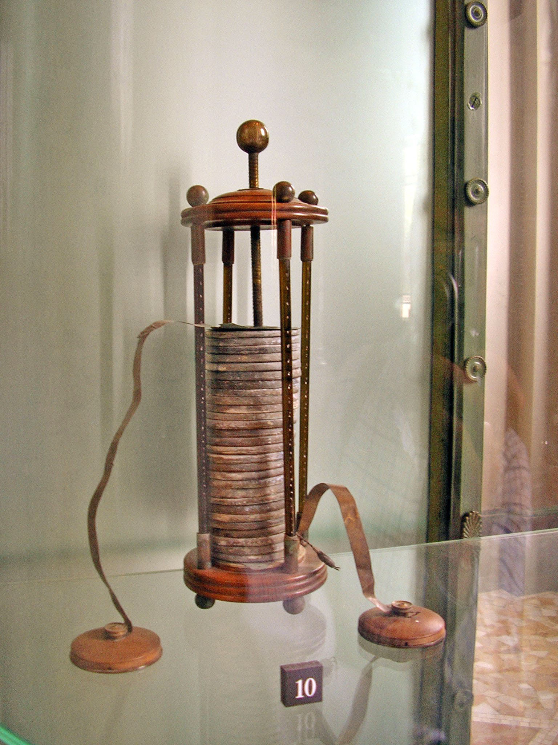
The First Battery?
Alessandro Volta's electric battery (Tempio Voltiano in Como, Italy) by GuidoB /CC-BY-SA-3.0
https://commons.wikimedia.org/wiki/File:VoltaBattery.JPG
Notes:
In our introduction to Unit 2, we talked about batteries as an important source of electrical energy that we use to run our mobile devices such as mobile phones, PCs, laptops and even bicycles or wheelchairs. Have you ever wondered who invented that first battery? I am sure you are curious to know. He is an Italian scientist by the name of Alessandro Volta. Let us now watch a short video segment on his pioneering work on electricity.

Slide 4
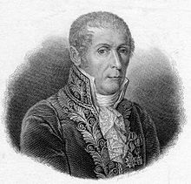
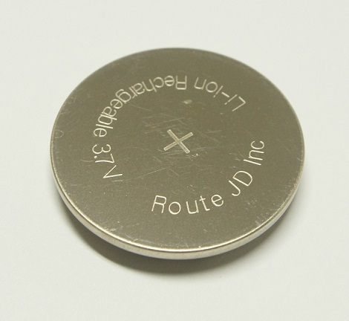
Father of Electricity
One of my greatest achievements is remembering my long name!
3.7 volts (V)
Alessandro Giuseppe Antonio Anastasio Volta
1745-1827
Notes:
He is Alessandro Volta. The following video segment will give us some insight to this great man and his pioneer work in the field of electricity.

Slide 5
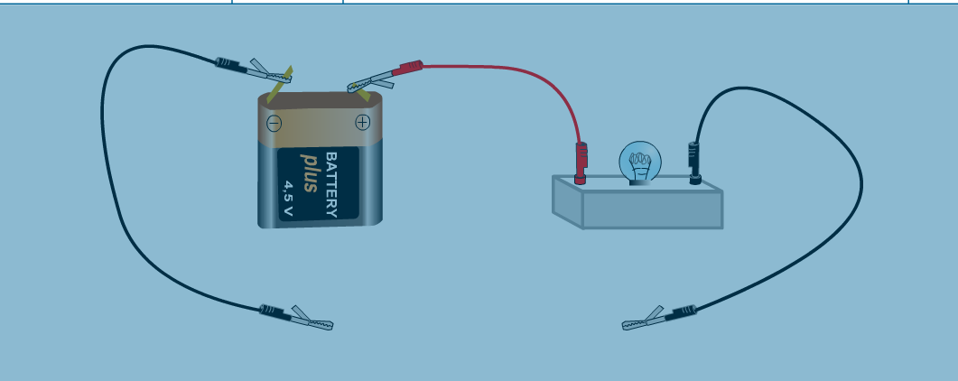
Voltage
Electrons flow through the circuit from the negative terminal of the battery to the positive terminal of the battery.
e⁻
e⁻
e⁻
e⁻
e⁻
e⁻
+
e⁻
V
_
e⁻
e⁻
e⁻
e⁻
e⁻
e⁻
e⁻

Slide 6
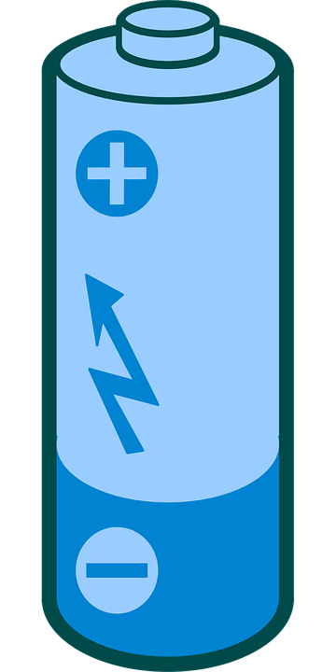

Voltage
e⁻
e⁻
e⁻
e⁻
e⁻
e⁻
∽
+
e⁻
V
_
e⁻
e⁻
e⁻
e⁻
e⁻
e⁻
e⁻
Just as water pressure pushes water out of a pipe, voltage is an electrical pressure that pushes electrons round a circuit.
Notes:
Voltage is likened to enthusiasm. If you are invited to a party that you would love to attend, voltage is likened to your enthusiasm. It is the potential for enjoyment, but you can only realise this enjoyment when you are at the party itself. If you are not interested in the party, your enthusiasm will be dampened

Slide 7
Voltage
The electric potential difference (voltage) between 2 points in a circuit moves the electric charge from one point to another.
Low
Potential
High Potential
−
−
−
−
−
−
V
_
+

Slide 8
Voltage
e⁻
e⁻
e⁻
e⁻
e⁻
e⁻
∽
+
e⁻
V
_
e⁻
e⁻
e⁻
e⁻
e⁻
e⁻
e⁻
A battery provides a potential difference to push electric charges to move around a circuit.
A battery is a source of electrical potential energy or electromotive force (EMF) that moves electric charges around a circuit.
The EMF of a battery is often referred to as the voltage of the battery.
Notes:
Voltage is likened to enthusiasm. If you are invited to a party that you would love to attend, voltage is likened to your enthusiasm. It is the potential for enjoyment, but you can only realise this enjoyment when you are at the party itself. If you are not interested in the party, your enthusiasm will be dampened

Slide 9
Voltage
e⁻
e⁻
e⁻
e⁻
e⁻
e⁻
+
e⁻
V
_
e⁻
e⁻
e⁻
e⁻
e⁻
e⁻
e⁻
Electric potential difference is also referred to as voltage or voltage difference.
The symbol of voltage is V.
The unit of voltage is volt (V).
Notes:
Voltage is likened to enthusiasm. If you are invited to a party that you would love to attend, voltage is likened to your enthusiasm. It is the potential for enjoyment, but you can only realise this enjoyment when you are at the party itself. If you are not interested in the party, your enthusiasm will be dampened

Slide 10
Voltage
Electronic symbol of a battery cell or a DC voltage source.
DC stands for direct current.
If this is a 9 V battery, the voltage across its two terminals = 9 V.
V
_
+
Positive Terminal (Anode) High potential
Negative Terminal (Cathode) Low potential
Notes:
We will now focus our attention to explain the term voltage.

Slide 11
Voltage & Electric Work
When electrical charges move from 1 point to another, energy is consumed or work is done.
Energy is consumed
Low
Potential
−
−
−
−
−
−
High Potential

Slide 12
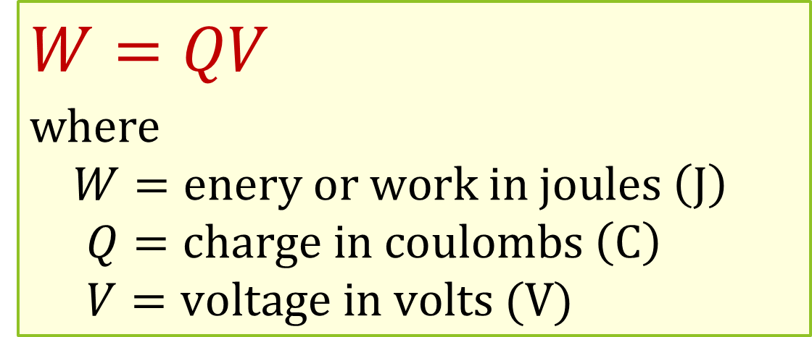
Voltage & Electric Work
When electrical charges move from 1 point to another, energy is consumed or work is done.
$$W=QV$$
where
$$W=enery or work in joules \left(J\right)$$
$$Q=charge in coulombs \left(C\right)$$
$$V=voltage in volts (V)$$

Slide 13
Voltage & Electric Work
The potential difference (voltage) between 2 points is 1 V when 1 J of energy is used to move 1 C of charge from one point to another.
1 Coulomb of charge
1 Joule of energy
Point A
Point B

Slide 14
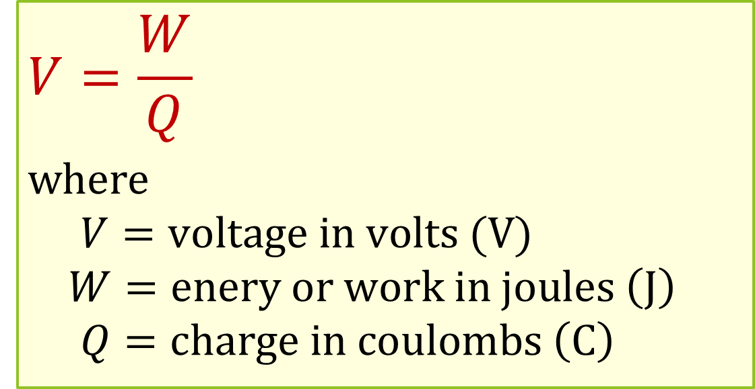

Voltage & Electric Work
$∵W=QV$, ∴ the voltage difference between two points is
$$V=\frac{W}{Q}$$
where
$$V=voltage in volts (V)$$
$$W=enery or work in joules \left(J\right)$$
$$Q=charge in coulombs \left(C\right)$$

Slide 15
Example 1
40 J of energy is needed to move 10 C of charge between 2 points in an electric circuit. What is the voltage between the 2 points in the circuit?

Slide 16
Example 2
The voltage between 2 points in a circuit is 10 V. How much energy is required to move 50 C between the 2 points?

Slide 17
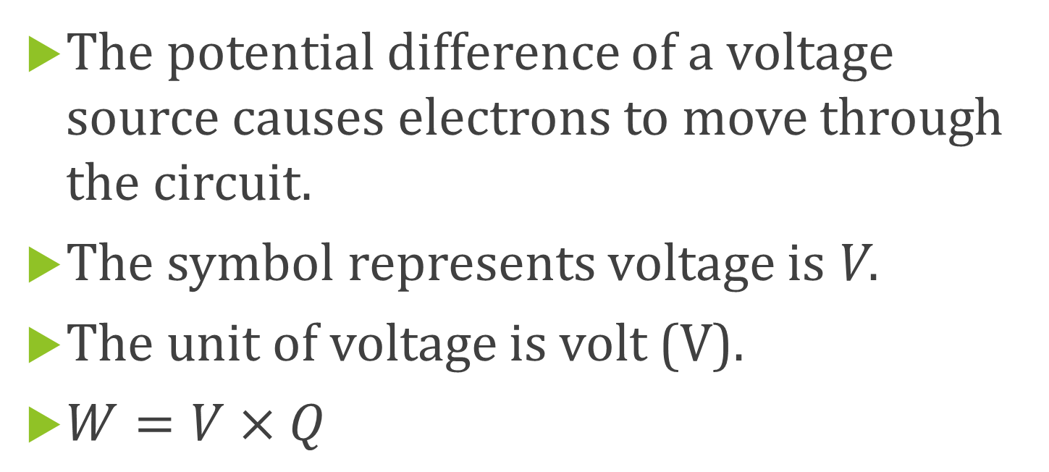
What have you learned?
The potential difference of a voltage source causes electrons to move through the circuit.
The symbol represents voltage is V.
The unit of voltage is volt (V).
$W=V×Q$

Slide 18
Coming Up Next
Unit 2 Part C: Current

